Slide 1
Close Reading
…with pictures

Slide 2
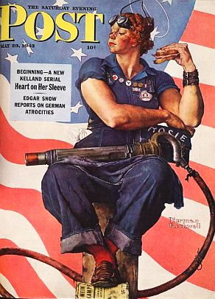
Glimpse One
“Rosie the Riveter” Norman Rockwell

Slide 3
Glimpse Two
“Rosie the Riveter” Norman Rockwell

Slide 4
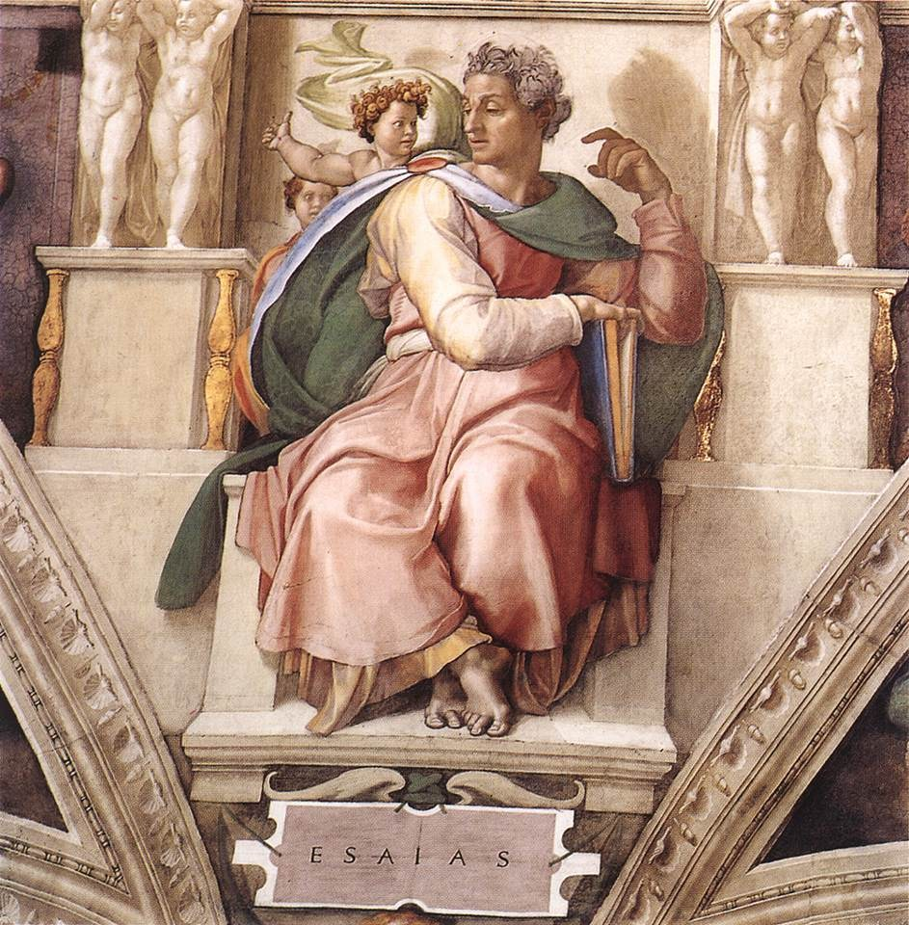
Second Image
“Prophet Isaiah” Michelangelo

Slide 5
New Perspective
http://www.history.com/topics/world-war-ii/rosie-the-riveter

