Slide 1
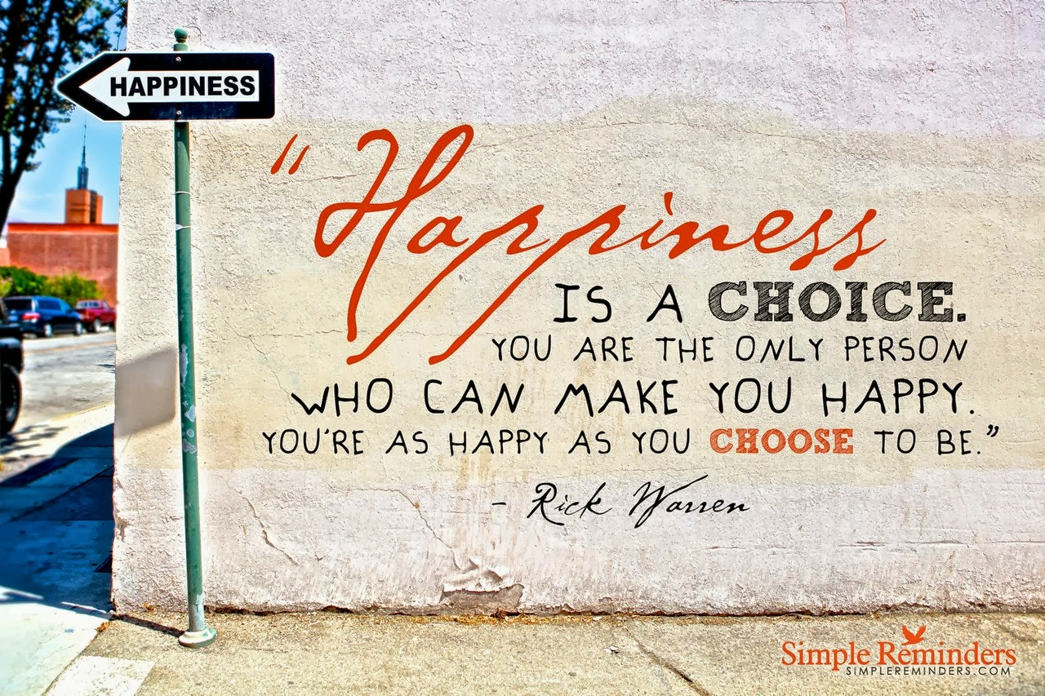
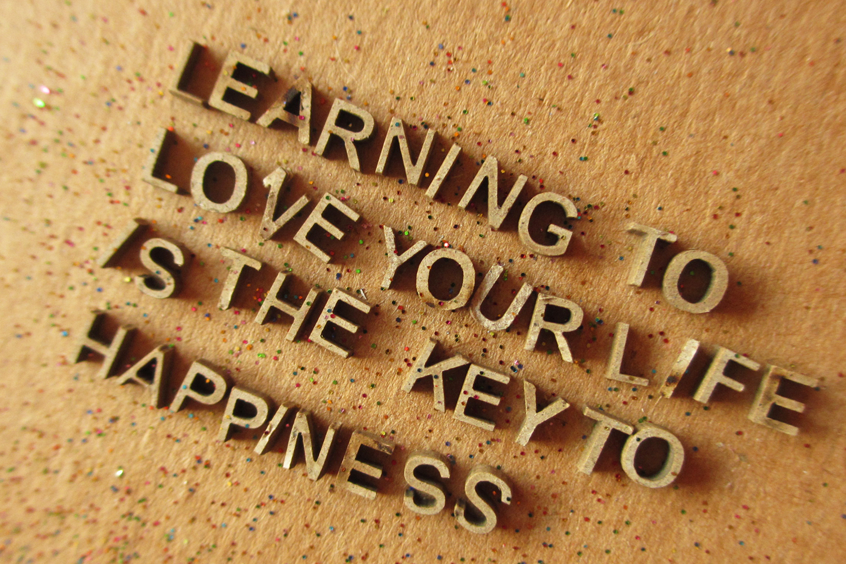
“happiness is like a butterfly, the more you chase it, the more it will evade you, but if you notice the other things around you, it will gently come and sit on your shoulder.”
Which of these depicts happiness the best?

