Slide 1
“The Scarlet Ibis”
Story Information and Visuals

Slide 2
What do you think this story will be about based on the picture you see here?

Slide 3
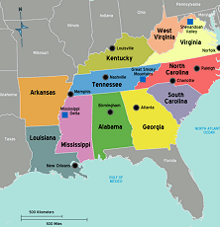
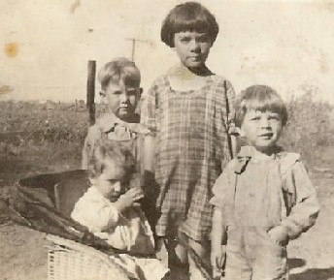
Setting
American South
1918 World War I just ended

Slide 4
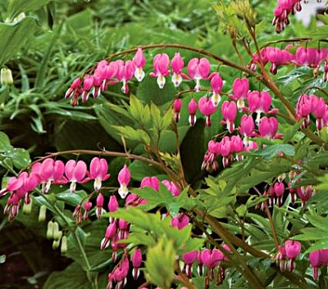
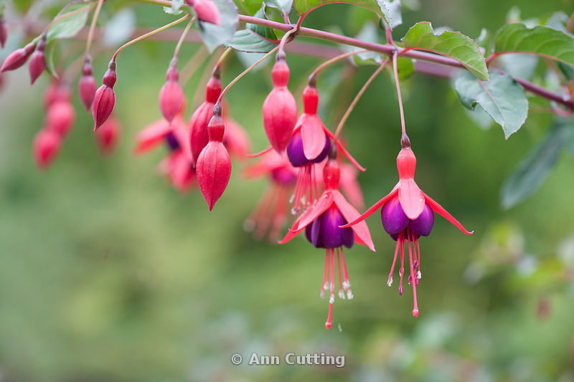
“the bleeding tree”
the bleeding tree—where the scarlet ibis is found
the blooms on the tree look as if they are bleeding.

Slide 5
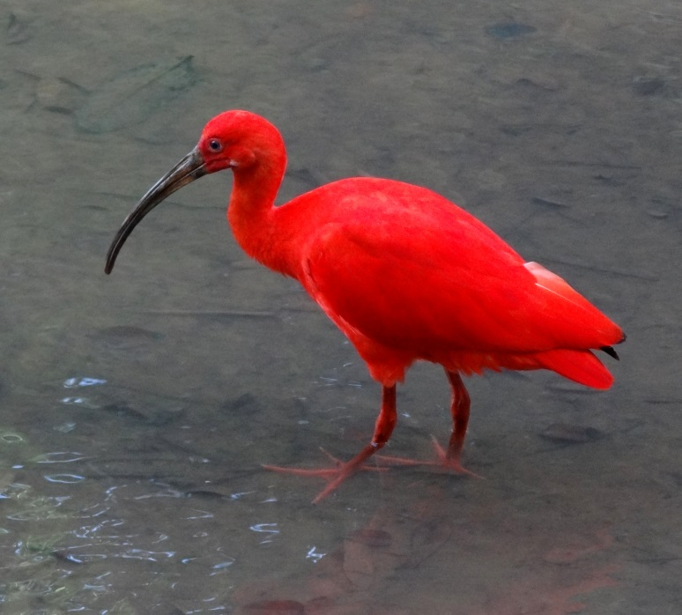
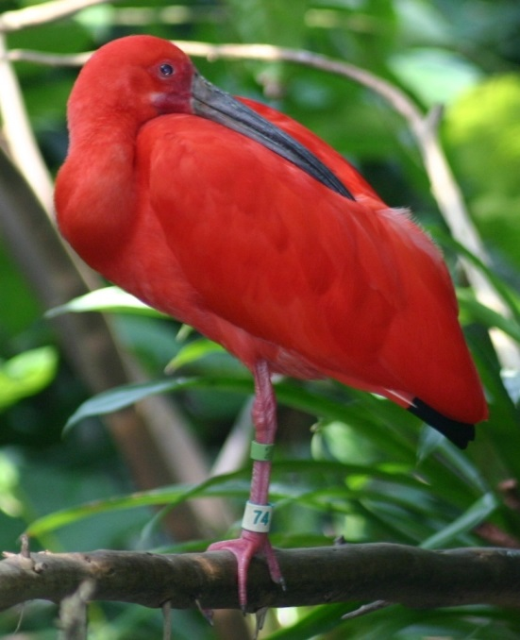
the scarlet ibis
exotic bird typically found in northern south America/Brazil and very deep South (rarely)
it is not typically seen in the US much less north of Florida
in captivity it can lose the deep red color of its feathers
central symbol of the story

