Slide 1
Meet the Teacher Night
Welcome Parents!

Slide 2
A little about Mrs. Chapman…
Meredith graduate, National Board Certified
mother of a 5 year old and a 12 month old
this is my 10th year
English Department Co-Chair
Yearbook Adviser
email: wchapman@wcpss.net
weekly emails/flyers ☺
I will challenge your students!!
Learning Experience much more valuable and meaningful than a grade!

Slide 3
English I
Class website: www.chapmanenglish.weebly.com
updated each day with the agenda and homework
also houses presentations and handouts from class
students who are absent should check the website for information regarding the day’s activities.
PowerSchool is updated on the 15th and 30th of every month

Slide 4
Grading
Participation 15%
homework when assigned and checked
classwork activities and participation
seminars (speaking and listening grade)
Vocabulary Skills 15%
weekly vocabulary sentences/activity
weekly vocabulary tests
Reading Techniques 35%
questions/study guides
reading quizzes
ACE Responses/Assessments that deal with a specific text that are graded based on knowledge of text
Seminars (read and completed pre-seminar activities)
Essay Preparation and Writing 35%
ACE Responses/Assessments which are graded on accuracy of process and writing skills
brainstorming, essays, creative responses, argumentative pieces

Slide 5
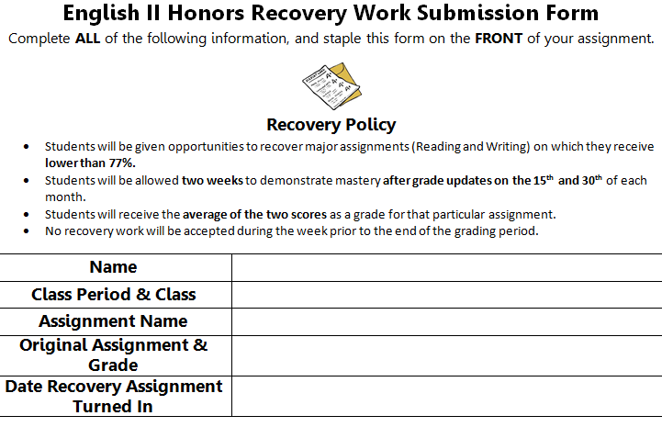
Recovery Policy
Below a 77% on major assignments (Reading Techniques and Essay Preparation)
Allowed two weeks to demonstrate mastery after grade updates on the 15th and 30th of each month
Receive the average of the two scores (original and second attempt) as a grade for that particular assignment.
No recovery work will be accepted during the week prior to the end of the grading period.
During the Flex Period
Your responsibility to ask me what is eligible for recovery and turn it in by the deadline.
No vocabulary quizzes, reading quizzes, or homework

Slide 6
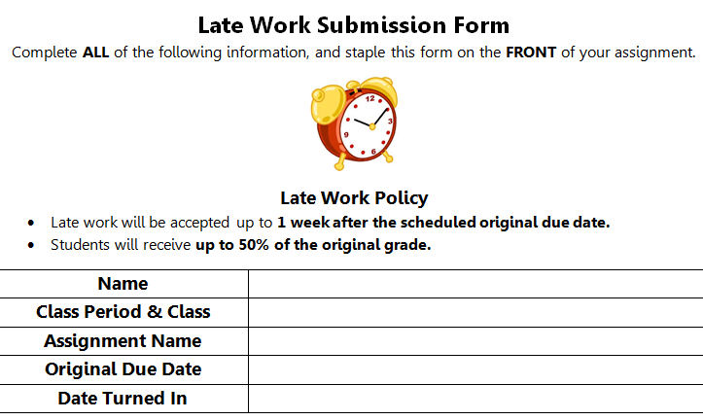
Late Work
Accepted up to 1 week after the scheduled original due date.
Receive up to 50% of the original grade.
Must submit a late work form with any late assignment. Form available on class website and in the classroom.
Your responsibility to ask me what is eligible for late work submission and turn it in by the deadline.
No late work will be accepted during the week prior to the end of the grading period.
No classwork assignments or assignments which we review during class.

Slide 7
If your student is absent…
Check the website!
They know not to ask me what they missed!
Upon return, they check the make-up work tray for anything that wasn’t posted.
Come to me during the Flex Period for clarification on assignments or to make-up quizzes or tests

Slide 8
Textbooks and Film
Textbook – purple but it will not come home with them
Supplemental Books – will come home and must be returned or replaced
Composition Notebook
Post-It-Notes and Highlighters for annotation
Clips of/Entire films

Slide 9
Questions?

