Slide 1
Short Stories Introduction
English I

Slide 2
Journal for “Know” Column
What do you know about short stories?
If nothing, what do you think a short story is?
Know

Slide 3
In the “Should Know” Column..
Write down the following words/phrases, leaving space underneath:
What is a short story?
Freytag’s Pyramid
Exposition/Basic Situation
Rising Action/Complications
Climax
Falling Action
Resolution
Setting
Characters
Point of View
Plot
Theme
Tone
Mood
If you need overflow, you should carry over to the next left and right hand pages, so turn the page and continue your chart on the left and right hand pages. For the left page, you can write “see previous page” for the “Know” Column.

Slide 4
What is a short story?
Short, concentrated fictional prose narrative
Usually focuses on one main plot, one main character, and one main theme
The plot follows a basic pattern.
Plot = series of related events that make up the story
Remember, the information you find on each of these slides is the information you will place in your “Learned “column beside the correct category.

Slide 5
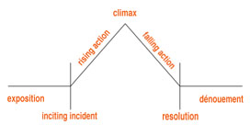
Freytag’s Pyramid
Draw a smaller version of this in your “Learned” column

Slide 6
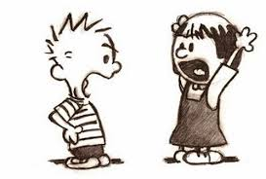
Exposition/Basic Situation
The opening of the story that provides information about the setting, the characters, and their conflict

Slide 7
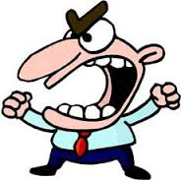
Rising Action/Complications
The series of conflicts or crises that lead to the climax of the story
Conflict = struggle or clash between opposing characters or opposing forces
Internal conflict – takes place entirely in a character’s own mind; a mental struggle
External conflict – a character struggles with an outside force, such as another character, society as a whole, or something in nature

Slide 8
Climax
The turning point in the story, usually when the conflict is decided one way or another
Key scene in the story
Most emotional and intense moment in the story
Peak of the plot diagram

Slide 9
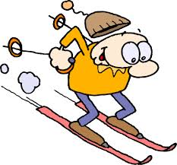
Falling Action
The action that occurs after the climax
Intended to bring the story to a satisfying end
May not be present in all stories

Slide 10
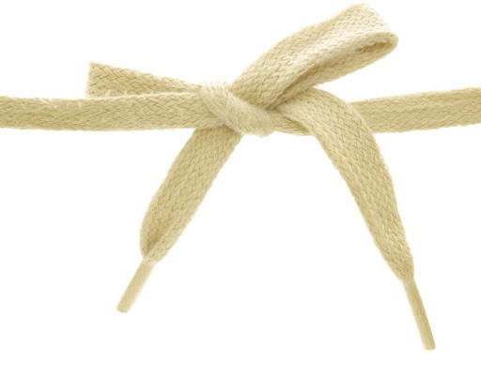
Resolution
Occurs at the end
All the struggles are over
The tying together of loose ends

Slide 11
Practice
Watch/follow the story, and complete Freytag’s Pyramid.
Goldilocks and the Three Bears

