Slide 1
“The Sniper”
Setting and Conflict Photographs

Slide 2
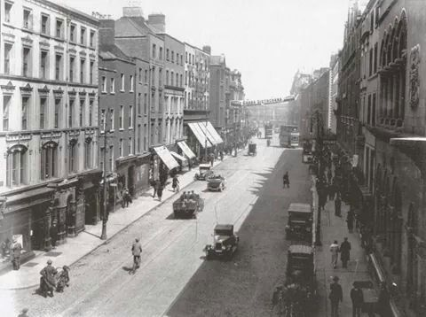
Dublin, 1920s

Slide 3
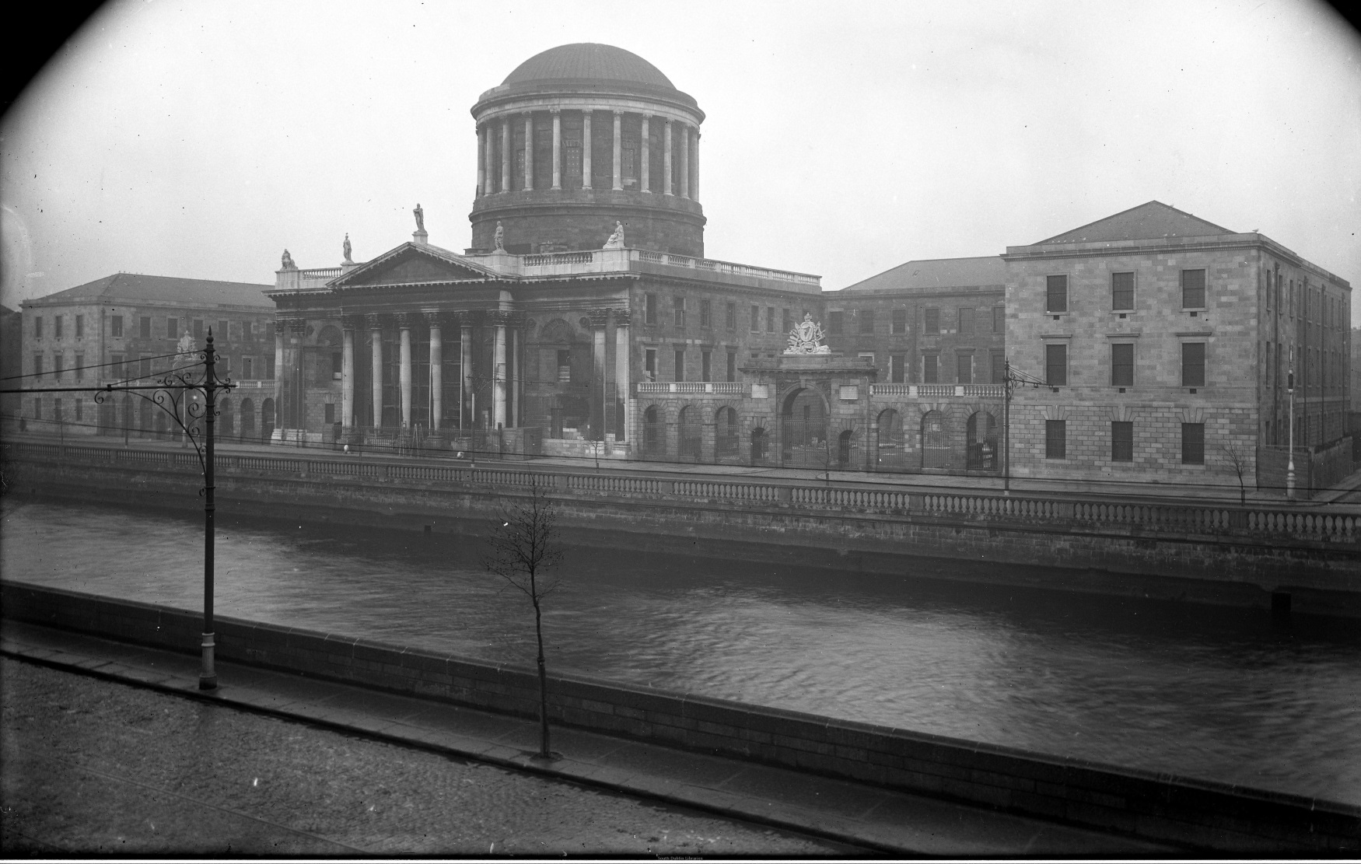
The Liffey and Four Courts
Liffey: river that runs through Dublin.
Four Courts: government buildings in Dublin

Slide 4
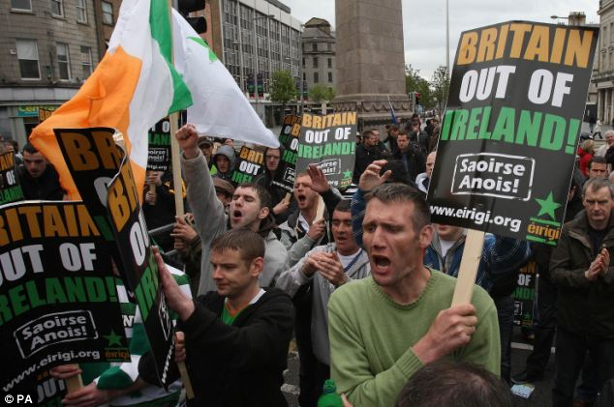
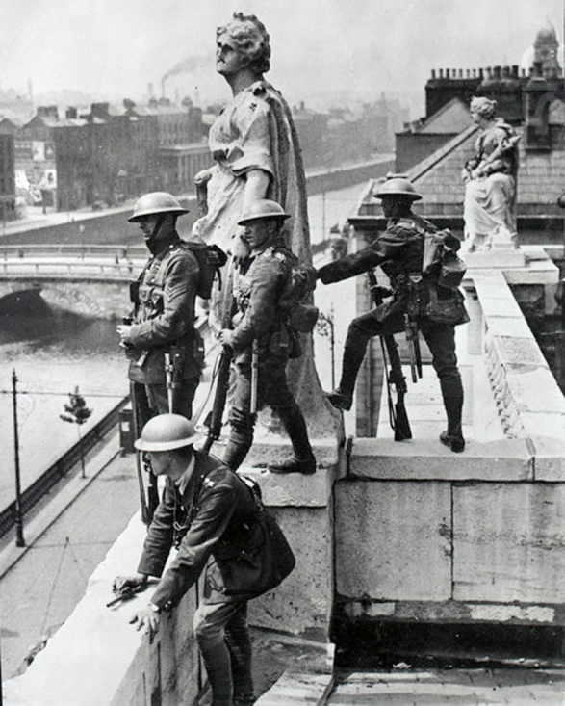
Republicans
Modern-day Irish Republicans protesting the before the Queen of England visits.
Republican soldiers in Dublin, 1920s

