Slide 1
Strong Answer Format
Adapted from the Toulmin’s Argument Model by the Sanderson High School English II PLT
What It Is and Why You Need to Use It!

Slide 2
Watch and Listen
In the clip, two sports commentators are arguing about the best quarterbacks in the NFL. Listen to both sides, and then we will reflect.
Top 3 NFL Quarterbacks

Slide 3
What is SAF?
SAF is how you should answer all questions that require support, data, or evidence.
Questions like...
What is the theme of this book?
What is your favorite color?
How does the author use figurative language to develop the short story's tone?
Who is going to win the Republican Presidential nomination?

Slide 4
Strong Answer Format (SAF)
Claim - What are you claiming? What are you trying to prove?
Data - Include data from the text to support, or prove, your claim. This should be in the form of a quote (with a citation) or specific examples from the text. If it is not a text-based question, then you must use data from your own readings, observations, or personal experiences.
Warrant - Connect the data to the claim. How does your data prove/support your claim? Elaborate as needed.
Conclusion - Make a concluding statement to bring your answer to an end.

Slide 5
When To Use SAF
Whenever you are answering a question that requires data, evidence, examples, support, or analysis
For most text-based questions (other than general questions about the plot)

Slide 6
Why Use SAF?
You will score better on your assignments.
It will help you better understand the texts we read in English II.
It will help you answer questions in other classes.
It is a BIG part of AP English III.
It will help you on the PLAN, the PSAT, the ACT, and the SAT.

Slide 7
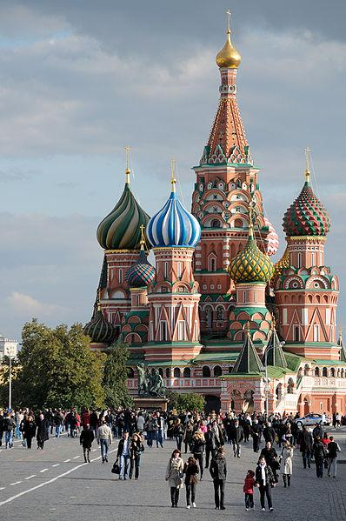
What is the most beautiful sight you have ever seen?
Claim - I have seen many beautiful things, but the most beautiful was Saint Basil's Cathedral in Moscow, Russia's Red Square.
Data - The cathedral is like no other I have ever seen before with its nine golden onion-domed towers and vividly-painted ornate walls.
Warrant - While most of the cathedrals that I have seen are beautiful, they are not as architecturally-interesting and brightly colored as Saint Basil's.
Conclusion - The combination of unique architecture and vivid colors easily make Saint Basil's Cathedral the most beautiful sight I have ever seen.

Slide 8
Practice
Answer one of the following questions on your handout as practice.
What is the best show on TV/Netflix currently?
What is the best movie?
What is the best book?
What is the most beautiful thing you have ever seen?

Slide 9
Chimamanda Adiche
In looking at the title of the video, to what do you believe a single story is referring?
Watch the video and following along with the script to find out the danger of a single story.
The Danger of a Single Story

