Slide 1
English II World Lit
With Mrs. Chapman

Slide 2
Housekeeping
Class website: www.mrschapmanswebsite.weebly.com
updated each day with the agenda and homework
also houses presentations and handouts from class
Students who are absent should check the website for information regarding the day’s activities.
PowerSchool is updated on the each Friday.

Slide 3
All things Grading
Academic Recovery Plan
Recovery Credit | Requirements | Our PLT
PowerSchool Grade Updates | Every Friday | Every Friday
Progress Report Distribution | Minimum of 4 ½ weeks | Progress reports every 4 ½ weeks and Power School checks biweekly during Flex Periods.
Recovery Work Due Dates (Teachers can accept recovery work up to one week before the end of the grading period.) | Time be determined by the PLT; differentiate between Academic and Honors classes | Academic Classes - Students will be allowed 2 weeks to demonstrate mastery after grade updates. .
Remediation Grades | Minimum of the average of the two grades but will not exceed 70% | Students will receive the average of the two grades (1st attempt and 2nd attempt).
Late Work Grades | Academic Minimum– 50% Honors Minimum- 40% | Late work will be accepted up to 1 week before the end of the quarter, as discussed with the teacher.

Slide 4
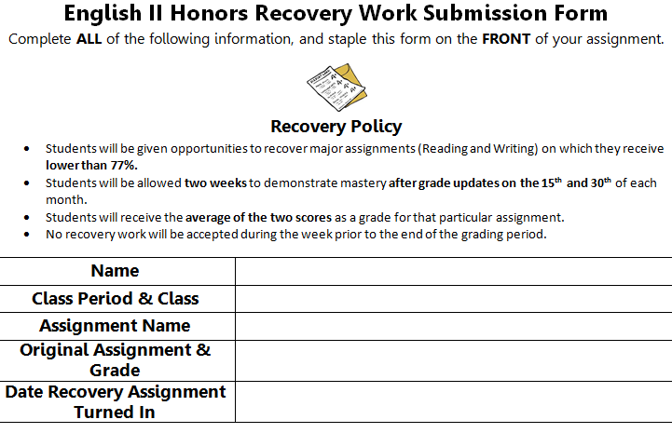
Recovery Policy Form

Slide 5
English II
Course Focus
World literature: fiction, non-fiction, drama, memoir, novels, poetry and short stories
Close Reading
Writing (short responses and essays)
Seminars/Class discussions
Grammar
Stem Vocabulary (continued from 9th grade)
Quarter Percentages and Exam
1st Quarter (37.5%)
2nd Quarter (37.5%)
Final Exam = EOC (25%)
Grading
Essay Preparation (35%)
Reading Techniques (35%)
Vocabulary (15%)
Participation (15%)

Slide 6
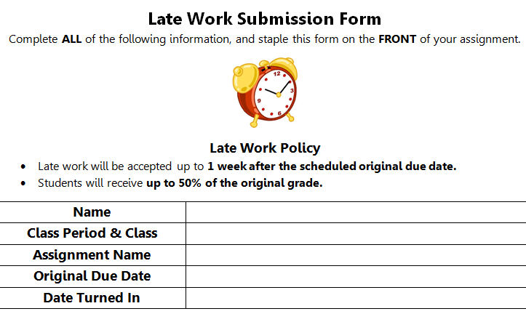
Late Work Form

Slide 7
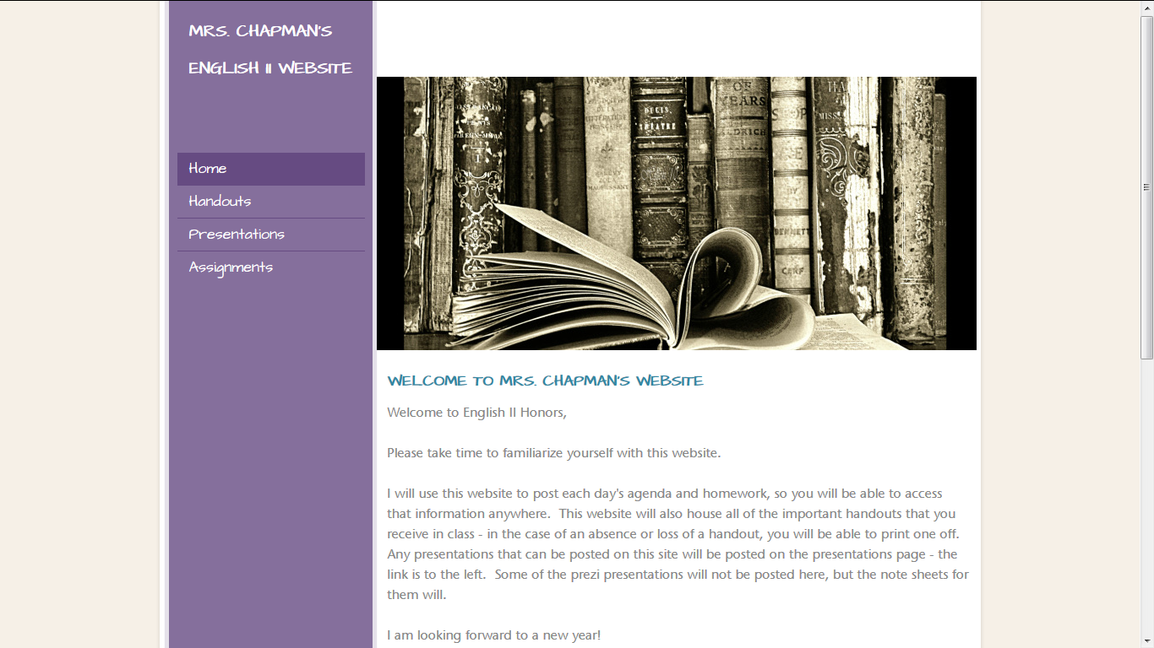
If you are absent…
Check the website!
Do not ask me what you missed!
upon return, check the make-up work tray for anything that wasn’t posted
email me or come to me before or after school to clarify any assignments

Slide 8
Classroom Expectations
Be Present.
Be Accountable.
Be Respectful.
Clean up after yourself!
Cell phones and Electronics
should be in designated bin unless I instruct you to use them for educational purposes
iPads or laptops should remain in your backpack unless I instruct you to get them out for educational purposes
Bathroom Policy
you have four passes for the semester – use them wisely

Slide 9
Classroom Procedures
Homework will be checked or taken up at the beginning of the class period.
You will complete DGP each day as the bell work activity.
You should begin the assignment as soon as the final bell rings.
Turn work into the appropriate In Box drawer
side bookshelf, front of the room
Please do not ask to use the restroom while I am teaching.
wait for a break
bring me one of your bathroom passes (otherwise, you will not be allowed to leave the room)
take the hall pass and excuse yourself
DO NOT LOSE IT!
Wear it!

Slide 10
Class Resources
Power School
Check your grades frequently!
Website: www.mrschapmanswebsite.weebly.com
Study Island: www.studyisland.com
Office Hours: Thursdays 2:30-3:30

Slide 11
For a little mind break
911 Call

